Slide 1
Learnest
GUIDED BY-
DR. VIVEK KAPOOR
Ashish malgawa
Fatema Engineeringwala
Samarth Jain

Slide 2
Why?
There is NO existing portal for our university.
Traditional methods of data sharing is much slower.
Sharing same content each year.
We need to pay to use existing E-Portal.

Slide 3
What is E-learning?
“The use of Internet technologies to deliver a broad array of solutions that enhance knowledge and performance”
Rosenberg, 2001

Slide 4
Evolution of Education Technology
Internet:
Greatest
impact
TIME
IMPACT
TIME

Slide 5
Traditional & E-learning Approach
Traditional and E-learning approaches
 | Traditional Classroom | E-Learning
Classroom | Physical – limited size Synchronous | Unlimited Anytime, anywhere
Content | PowerPoint/transparency/etc Textbooks/library Video Collaboration | Multimedia / simulation Digital library On demand Syn & Asyn. Communication
Personalisation | One learning path | Learning path and pace determined by learner

Slide 6
Benefits
Convenient
  self-service
  on-demand
  private learning
  self-paced
  Flexibility

Slide 7
Problem Domain

Slide 8
Each year students need to buy a lot of books and sometimes just for a few topics
Finding content from a traditional book also becomes a tedious task if you just need to read a paragraph or two from the whole chapter
A traditional lecture does not ensure long term retention of the content.

Slide 9
Cont..
Even after the dawn of internet a user need to browse numerous websites to quench their thirst for the knowledge and data that they are looking for and getting the right information from the right source still remains a challenge.
Furthermore, attending each and every class is something which is not always possible due to various reasons.

Slide 10
Literature Survey

Slide 11
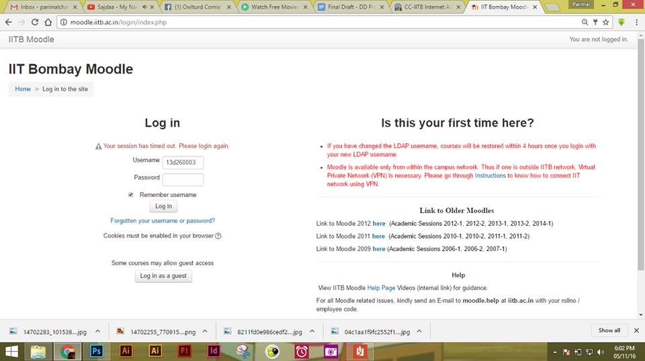
IIT Bombay Moodle (Login Page)

Slide 12
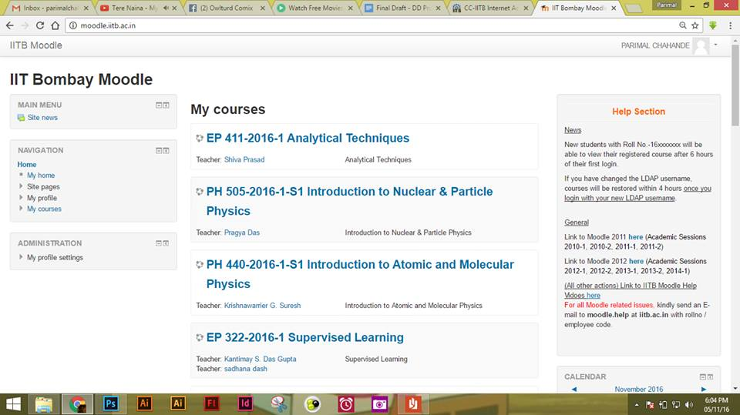
IIT Bombay Moodle (Home Page)

Slide 13
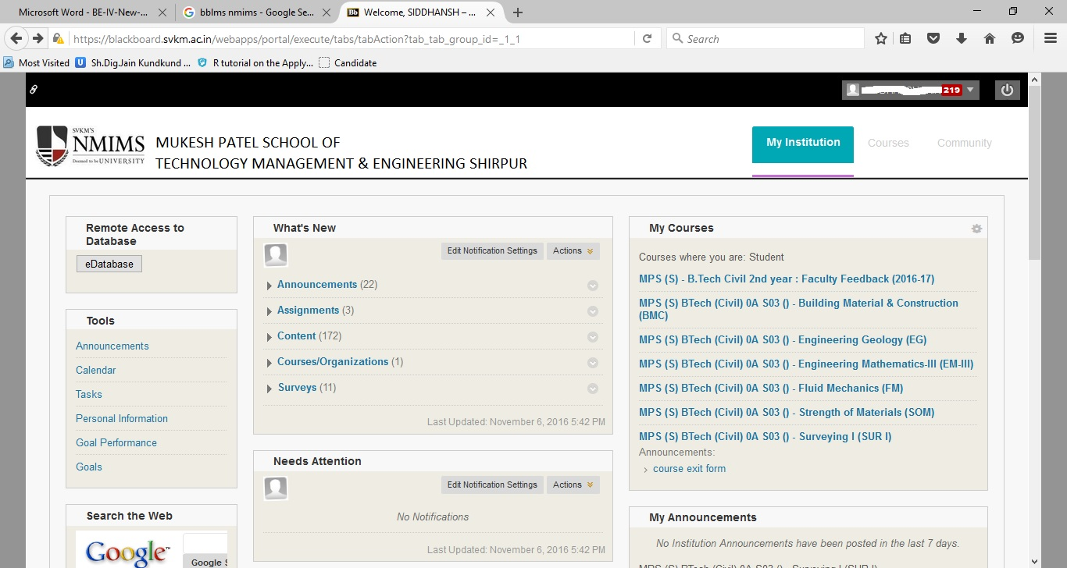
NMIMS HOME PAGE

Slide 14
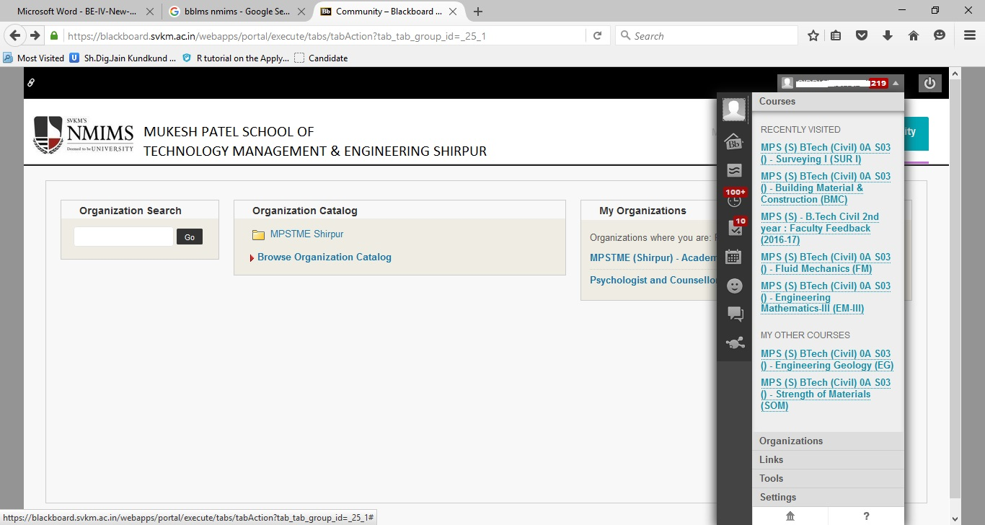
NMIMS PROFILE MENU

Slide 15
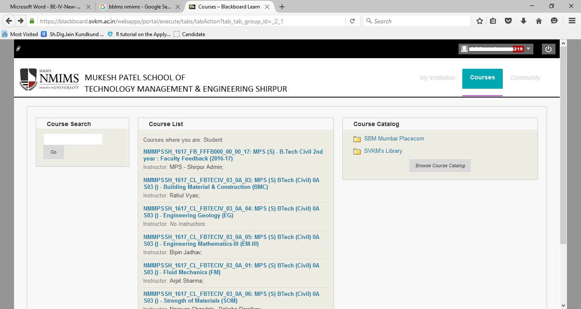
NMIMS COURSES

Slide 16
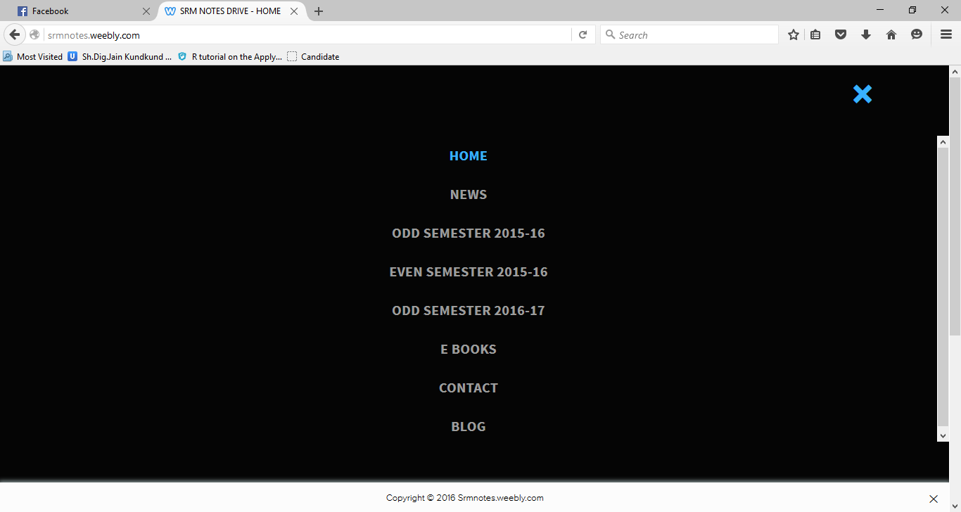
SRM weebly (MENU)

Slide 17
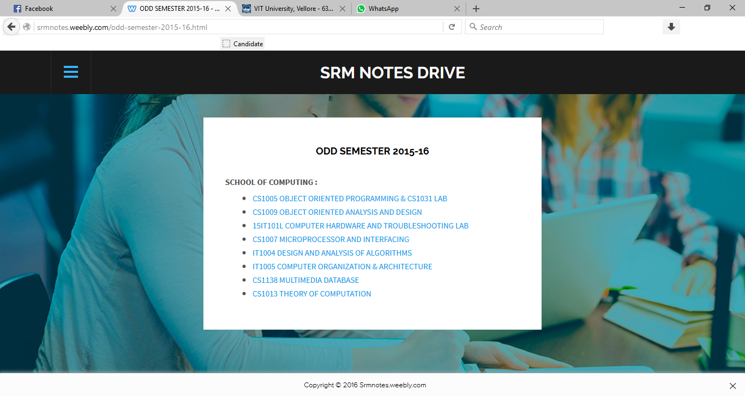
SRM WEEBLY (NOTES’ LINK)

Slide 18
Circumlocution
At the end of this coarse you will
Know what bad elearning looks like
Know that this is bad elearning
Understand why bad e-learning is bad
Know some eLearning pet peeves
Never want to see bad elearning again

Slide 19

Text Over Image
Text typed over images is hard to read.
There are ways to make it easier, like adding shadow, but it’s just better to not have text on top of images.

Slide 20
Solution Domain

Slide 21
Building an e-learning culture
Teacher:
Develop knowledge & skills
Understand learning and its need
Facilitate learning
Create learning opportunities
Learner:
Self-directed
Self-motivated
Self-regulating
Lifelong learning
Building an
E-learning
Culture
Administrator:
Create Learning environment
Provide ICT infrastructure
Resources for lifelong learning

Slide 22
Saves Time and Money.
Recorded lectures can be viewed multiple times resulting in long term retention.
Once the material (documents, lectures and ppts) is uploaded, the faculty does not need to upload the same content again and again each year. This will also smoothen the process of distributing the files among the students.

Slide 23
Technologies Used
Angular JS
HTML5
BootStrap
PHP

Slide 24
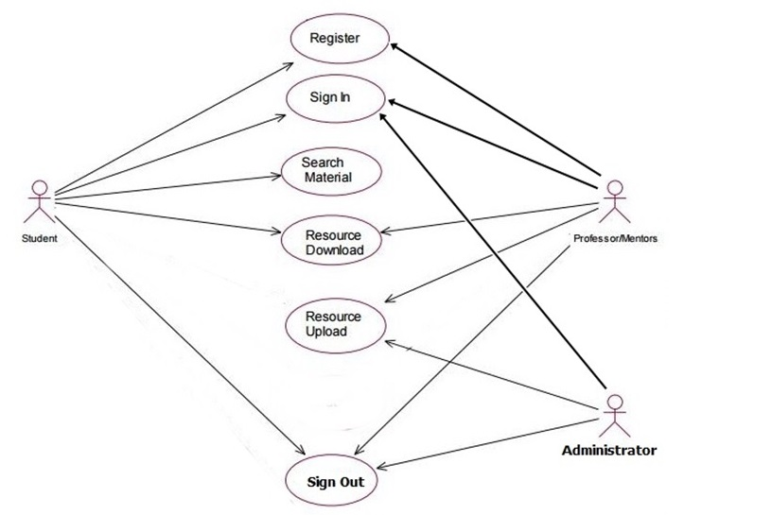

Slide 25
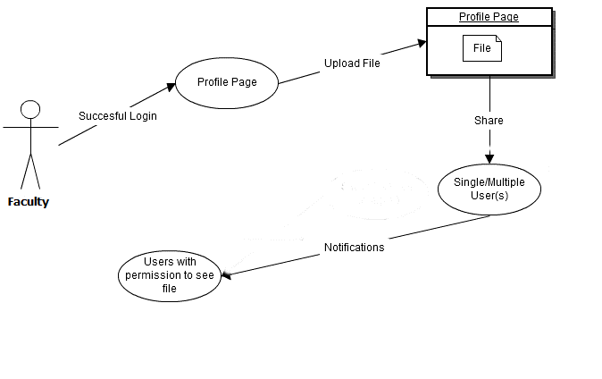
SERVICES PROVIDED TO THE FACULTY

Slide 26
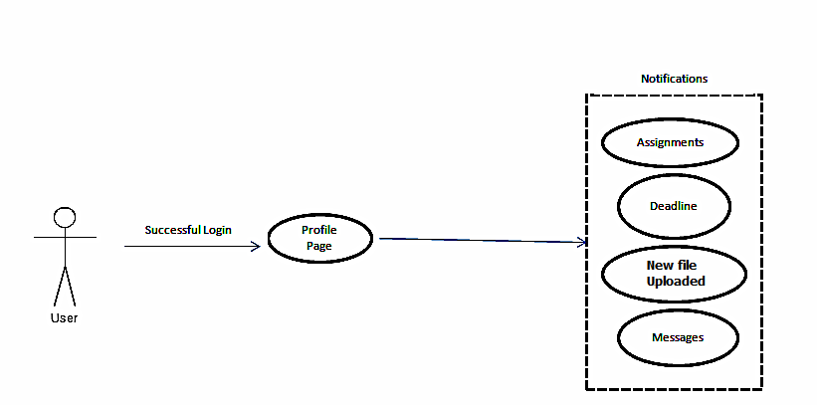
SERVICES PROVIDED TO THE STUDENTS

Slide 27
Conclusion
After the completion of this project we will gain more expertise in creating a website, its documentation and other things related to the project.
The limitations of our website are the hardware and software constraints which are required minimally in order to run the website, also the system should have a stable internet connection; without it the user won’t be able to access our website.
Furthermore, it also requires a good knowledge of English language and the user should know how to operate a computer.

Slide 28
Cont..
After the completion of the project, a portal will be available to all the students of our university giving them free and easy access to course material.
Students will be able to communicate with their respective faculties and vice-versa.
The Faculties will be able to upload their notes and other material once and for all the students.

Slide 29
